Slide 1
Companion
Team 5 : Maroon 5
Aarjav Dutt Anuja Waikar
Astha Rastogi Swagath V C
Aditya Mohan Kumar

Slide 2
VISION
For “individuals”
Who are “facing challenges in finding the activities of their interest”
Our “Companion app is a one-stop solution for multiple domains”
That provides “individuals with a single platform to get recommendations related to their
interests”
Unlike “Google or Facebook or Yelp”
We offer “personalized recommendations to enable an intelligent assistant, with an amazing
user experience and relevant results ”

Slide 3

UNMET NEEDS
One Stop Solution
Relevant Results
Clarity of Choice
User Friendly App

Slide 4

CUSTOMER SEGMENTS
Recommendation Seekers
Recommendation
Providers
Users in search of personalized recommendations, Students, Tourists, Hobbyist.
Event Organizers, Restaurant Owners, Hoteliers, Designers, Musicians, Movie Distributors etc. trying to reach relevant interest groups.

Slide 5
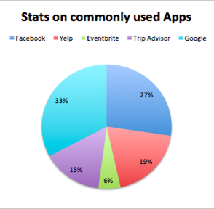





Existing Solutions

Slide 6
USE CASES
Recommendation Seekers
Recommendation Providers
He creates a profile on companion
Enters preliminary information about himself
Chooses the domains he’s interested.
Clicks on filters to fine tune his search based on sub domains.
Answers pop up questions trying to know his interests in a particular domain.
Finds the recommendations in the notification tab.
He creates a profile on companion
Enters preliminary information about himself
Chooses the domains he’s interested.
Clicks on filters to fine tune his search based on sub domains.
Answers pop up questions trying to know his interests in a particular domain.
Finds the recommendations in the notification tab.

Slide 7

Market Size
Smartphones users in US (2018) is the Total Addressable Market (TAM)
237 million
Note: Our App captures multiple domains. it is difficult to estimate the actual market size. But by analyzing our competitor's statistics in a few domains, such as Food, Travel, and events, We can estimate our Market Size.

Slide 8
Market Size
Domain | Market Size
Restaurants (Google) | 13 million
Restaurants (Yelp) | 12 million
Shopping (Yelp) | 14 million
Events (Eventbrite) | 50 million
Music (Spotify) | 180 million

Slide 9
Risks
Privacy concerns
Lack of user support
Legal concerns
Technical viability
Cost

Slide 10
THANK YOU

